Slide 1
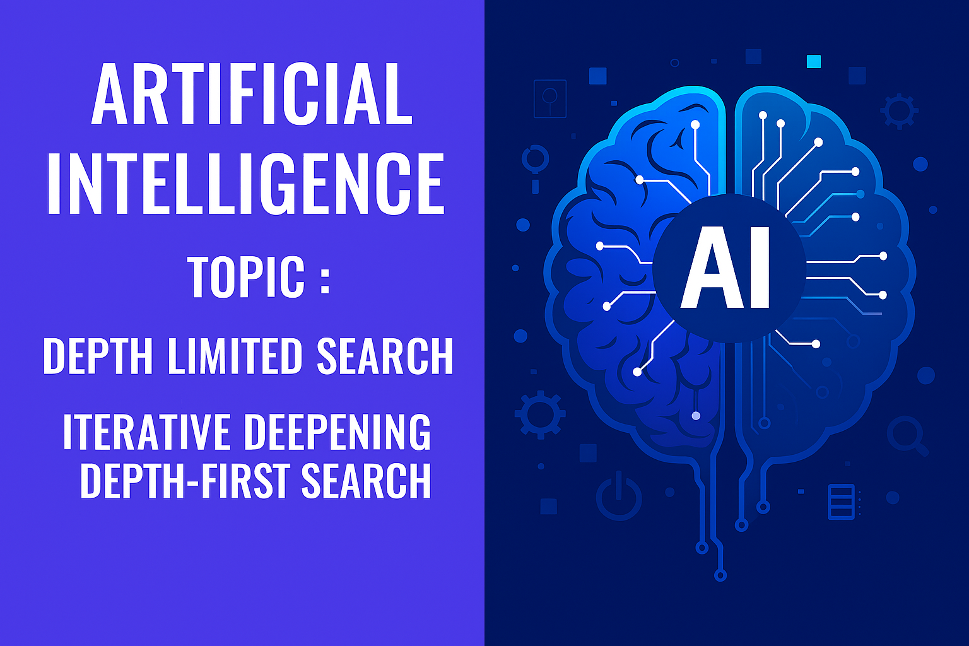
Presented by:- Aman Kr. Gupta

Slide 2

INDRODUCTION TO SEARCH TECHNIQUES
“In Artificial Intelligence, Search techniques are universal problem-solving methods. Rational agents or Problem-solving agents in AI mostly used these search strategies or algorithms to solve a specific problem and provide the best result. Problem-solving agents are the goal-based agents and use atomic representation. In this topic, we will learn various problem-solving search algorithms.”
e

Slide 3

Search Algorithm Terminologies:
Search: Searching is a step by step procedure to solve a search-problem in a given search space. A search problem can have three main factors:
Search Space: Search space represents a set of possible solutions, which a system may have.
Start State: It is a state from begins the search.
Goal test: It is a function which where agent observe the current state and returns whether the goal state is achieved or not.

Slide 4

Properties of Search Algorithm
Completeness: A search algorithm is said to be complete if it guarantees to return a solution if at least any solution exists for any random input.
Optimality: If a solution found for an algorithm is guaranteed to be the best solution (lowest path cost) among all other solutions, then such a solution is said to be an optimal solution.
Time Complexity: Time complexity is a measure of time for an algorithm to complete its task.
Space Complexity: It is the maximum storage space required at any point during the search, as the complexity of the problem.

Slide 5
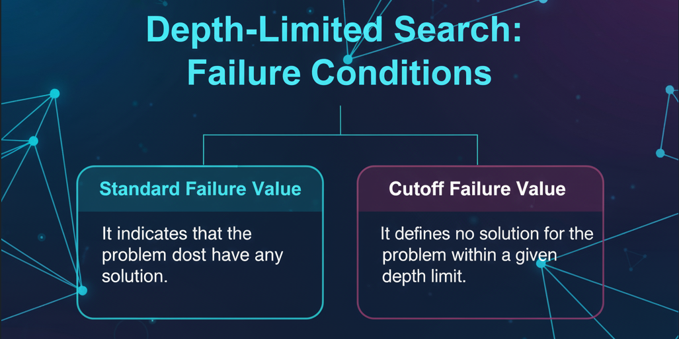
Depth Limited Search
A depth-limited search algorithm is similar to depth-first search with a predetermined limit. Depth-limited search can solve the drawback of the infinite path in the Depth-first search. In this algorithm, the node at the depth limit will be treated as if it has no successor nodes further.

Slide 6
Depth Limited Search(Algorithm):-
A depth-limited search algorithm is similar to depth-first search with a predetermined limit.
Depth-limited search can solve the drawback of the infinite path in the Depth-first search.
In this algorithm, the node at the depth limit will treat as it has no successor nodes further.
(It may not be optimal if the problem has more than one solution.)

Slide 7
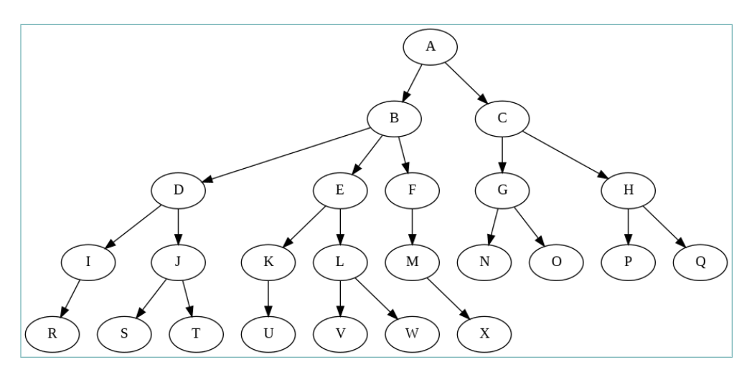
Example:-
Level 0
Level 1
Level 2
Level 3
Level 4

Slide 8
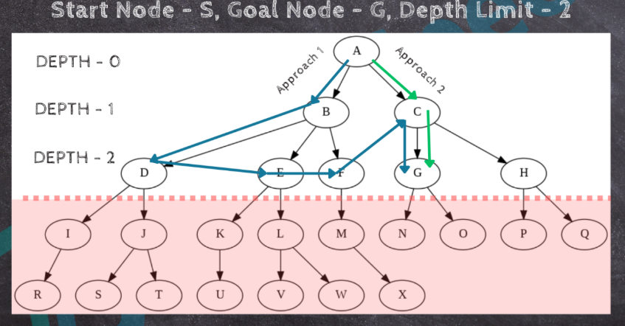
Solution:-

Slide 9
Advantages:-
Memory Efficient: Stores only the current path up to the depth limit.
Avoids Infinite Loops: Prevents DFS from going down endless paths.
Disadvantages:-
Incomplete: May miss solutions beyond the depth limit.
Not Optimal: Might return a longer or costlier path even if a better one exists.

Slide 10
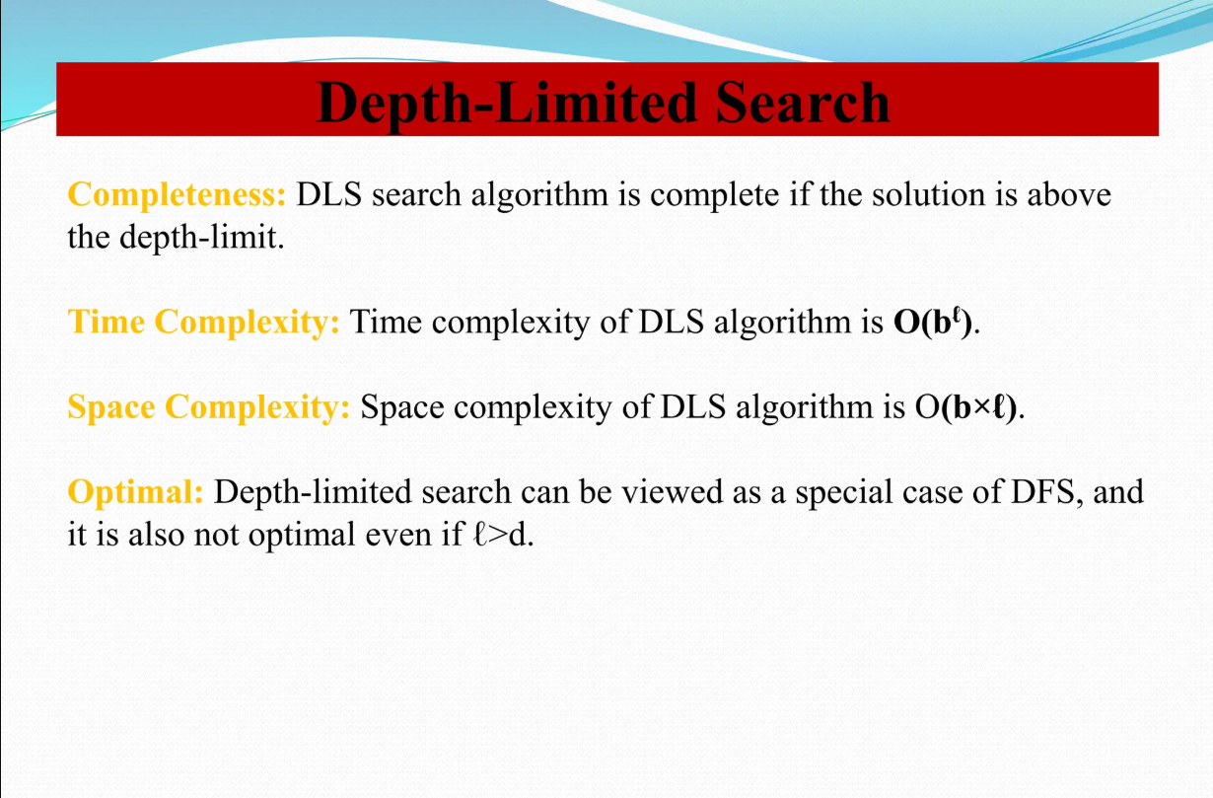

Slide 11
Iterative Deepening Depth-First Search:
The iterative deepening algorithm is a combination of DFS and BFS algorithms. This search algorithm finds out the best depth limit and does it by gradually increasing the limit until a goal is found.
This algorithm performs depth-first search up to a certain "depth limit", and it keeps increasing the depth limit after each iteration until the goal node is found.
This search algorithm combines the benefits of Breadth-first search's fast search and Depth-first search's memory efficiency.
The iterative search algorithm is useful in uninformed search when the search space is large, and the depth of the goal node is unknown.

Slide 12
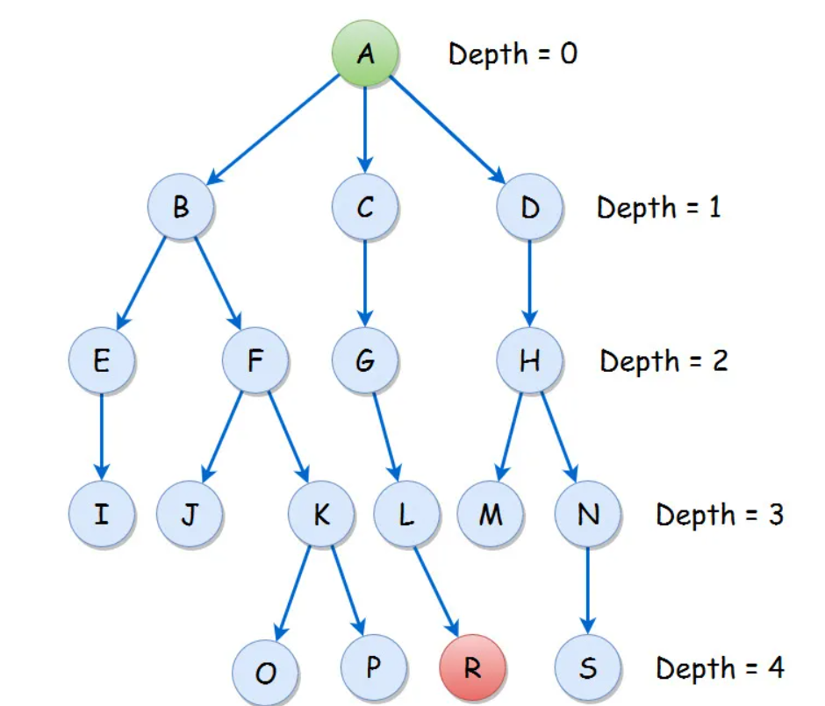
Example:-
Iteration’s:-
A
A B C D
A B E F C G D H
A B E I F J K C G L D H M N
A B E I F J K O P C G L R D H M N S

Slide 13
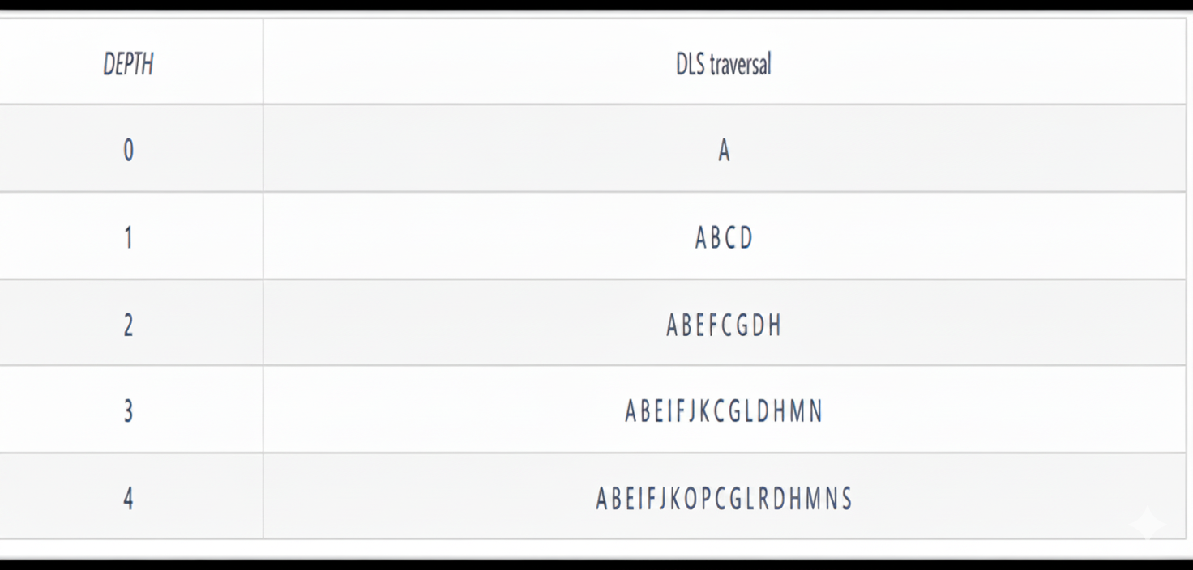
Solution:-

Slide 14
Advantages:-
Combine the advantage of both DFS and BFS
It is Complete & Optimal
Will not go in infinite loop
Disadvantages:-
Regressive Recursion is required
May require more memory

Slide 15
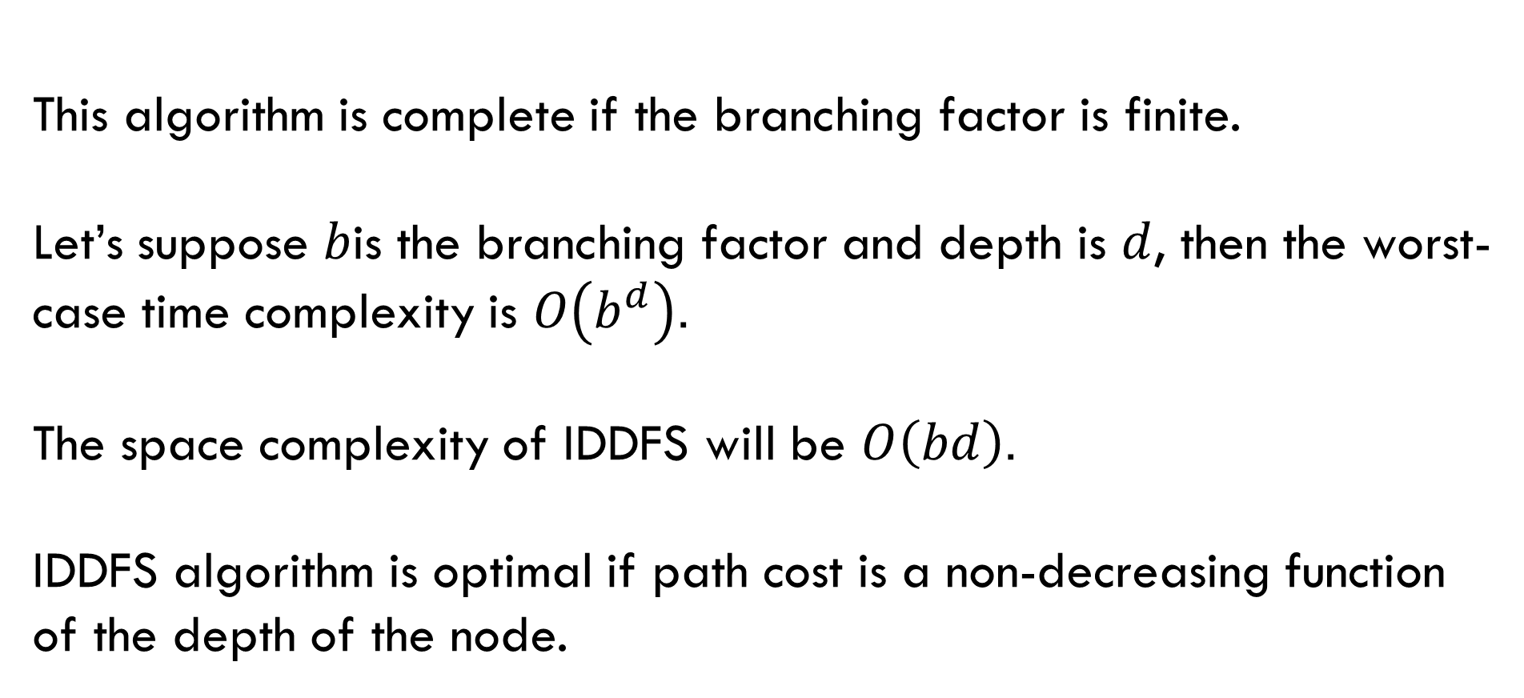
IDDFS(Properties):
Completeness:
This algorithm is complete if the branching factor is finite.
Time Complexity:
Let’s suppose $b$is the branching factor and depth is $d$, then the worst-case time complexity is $O\left(b^{d}\right)$.
Space Complexity:
The space complexity of IDDFS will be $O\left(bd\right)$.
Optimal:
IDDFS algorithm is optimal if path cost is a non-decreasing function of the depth of the node.

Slide 16

SOURCE: - GEEKS FOR GEEKS
LINKEDIN POSTS

